Slide 1
Research Design and Analysis I
EDUC/PSY 6600
Unit 0

Slide 2
Welcome

Slide 3
Data, Data, Data, Data, Data, ...
Tesla Autopilot

Slide 4
Data, Data, Data, Data, Data, ...

Slide 5
Data, Data, Data, Data, Data, ...
Health Care Policy and Cost

Slide 6
Data are/is Cool
“In God we trust. All others must bring data.”
W. Edwards Deming
“It is a capital mistake to theorize before one has data.”
Sherlock Holmes, “A Study in Scarlett” (Arthur Conan Doyle).
“You can have data without information, but you cannot have information without data.”
Daniel Keys Moran

Slide 7
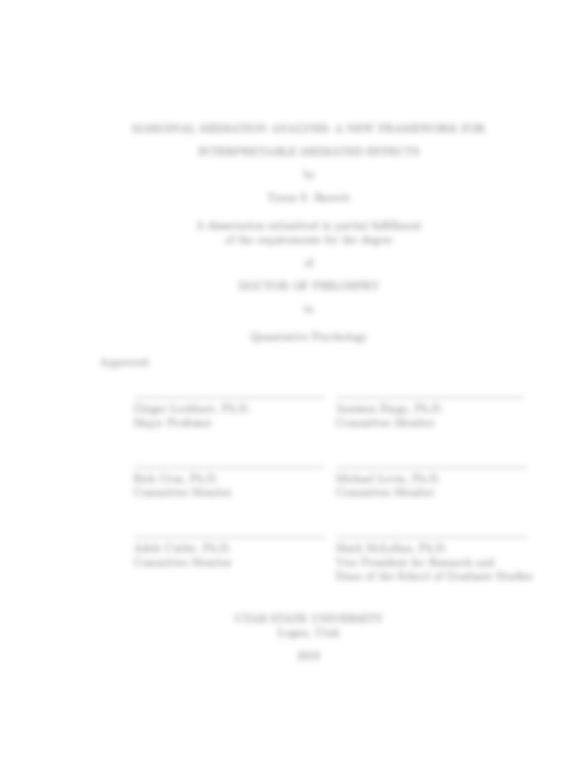

Purpose of this course
Develop quantitative skills
Prepare you for:
Your thesis
Your career
Notes:
Thesis: perform you own analyses and interpret them
Career: communicate with, work with, and understand statisticians and data scientists that you will be working with (they are everywhere…)

Slide 8
What is expected of you
Attend and participate in class
Prepare for class (readings before class)
Professional correspondence with colleagues
Use assignments to learn
Ask questions
Communicate with me

Slide 9
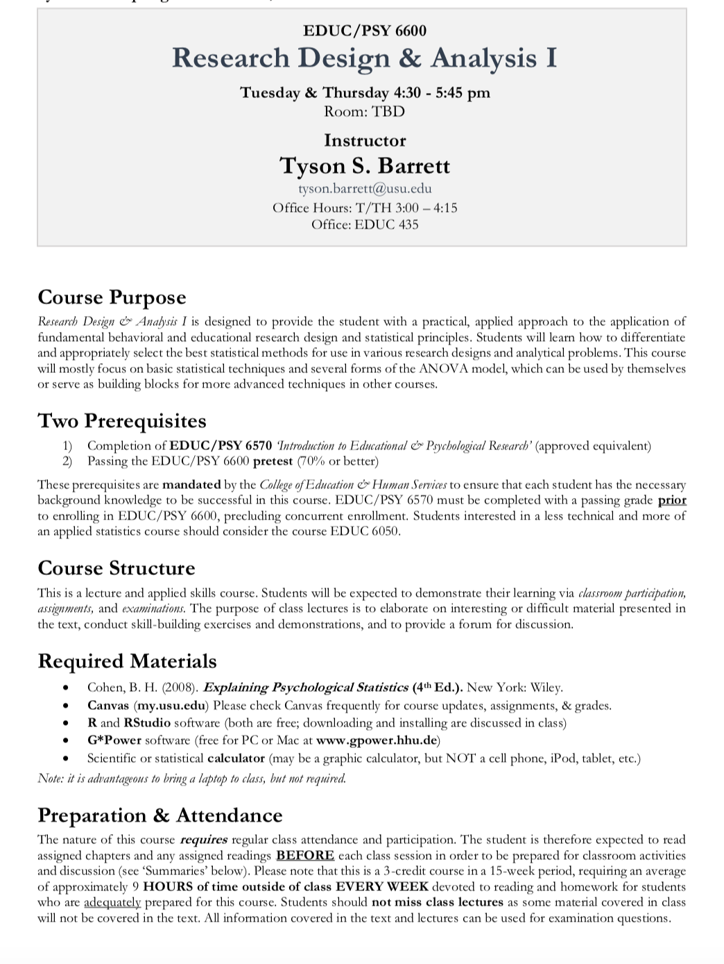
Who am I?
Research Assistant Professor
EDUC 435
tyson.barrett@usu.edu
Office Hours: 3:00 – 4:15

Slide 10
Prerequisites
EDUC/PSY 6570
Pretest
Mandatory
Can take the pretest up until the end of this week

Slide 11
Prep and Attendance
Prepare for class
It makes the lectures much more meaningful and less stressful
We’ll talk about the schedule in a moment

Slide 12
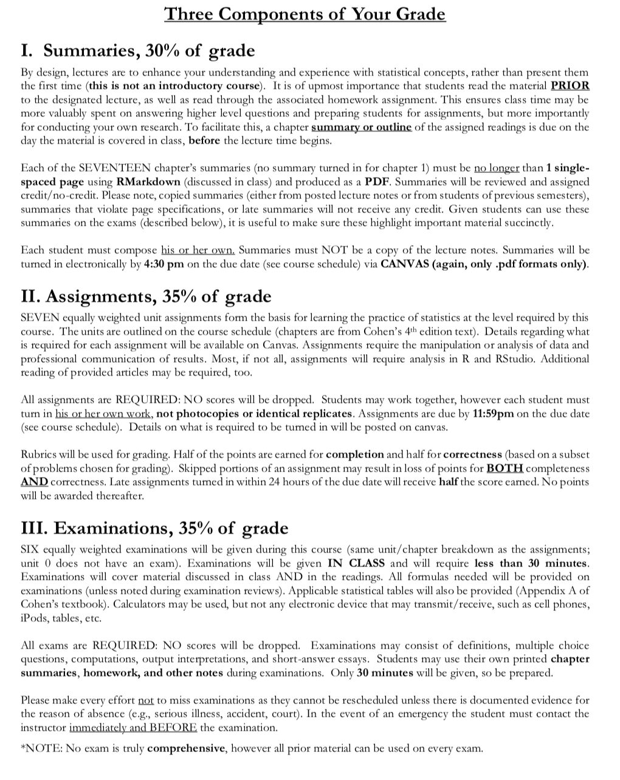
Grading

Slide 13
Grading
Summaries
30% of Grade
Essentially free points
-> Can use on Exams
Use RMarkdown (we’ll discuss a lot more)

Slide 14
Grading
Assignments
35% of Grade
10 journal articles in your area using quantitative research

Slide 15
Grading
Exams
35% of Grade
6 Equally weighted
Only 30 min
Open note (use your summaries)

Slide 16
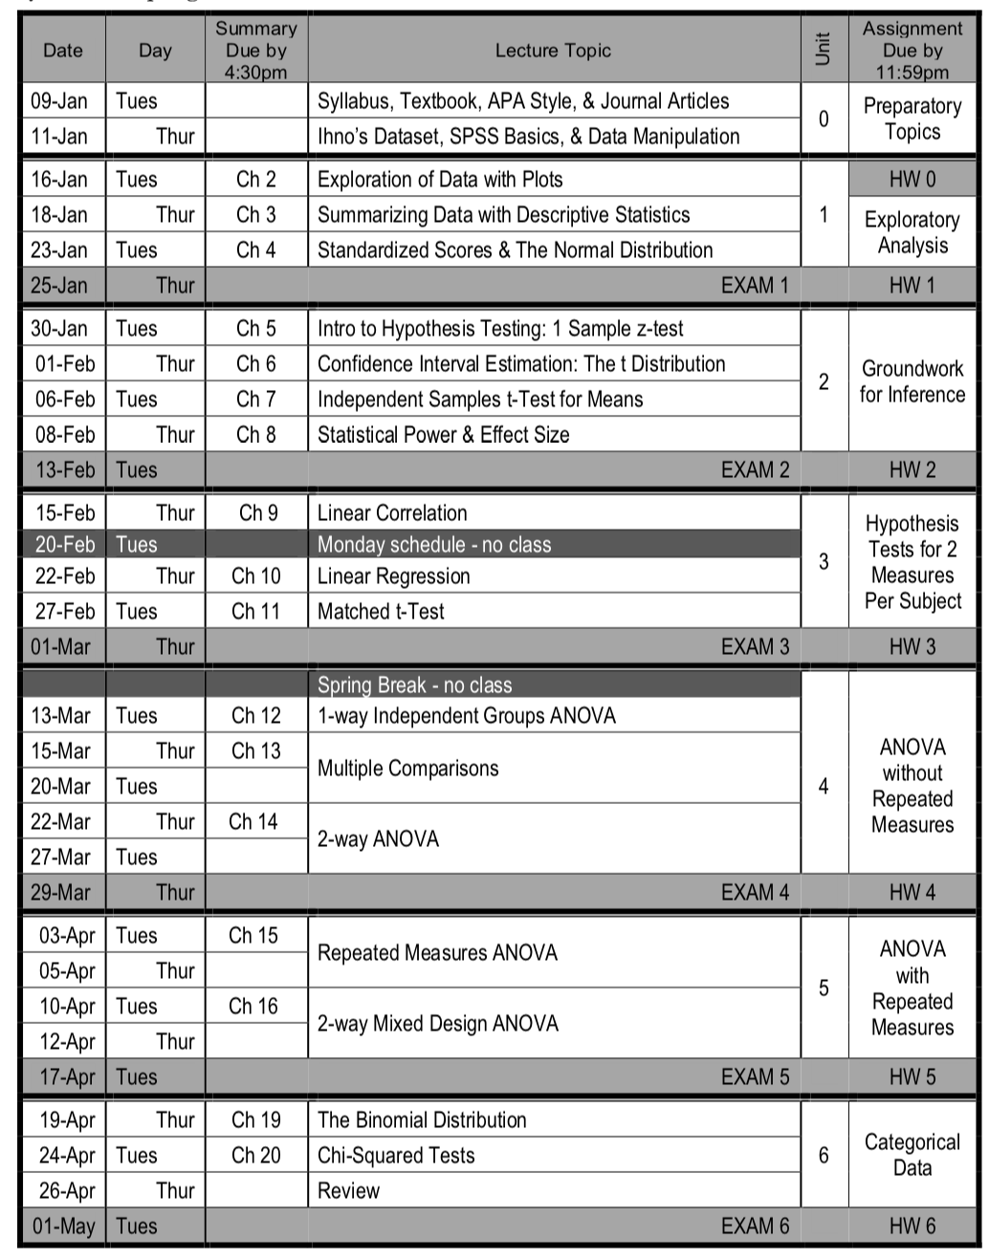
Schedule
Tentative
Summaries (and readings) are due before class
Assignment by the end of the day

Slide 17
Schedule
Tentative
Summaries (and readings) are due before class
Assignment by the end of the day
Please read the
syllabus in depth

